Slide 1
MASTERPIECES OF WESTERN ART Art Humanities W1121 Section 15
The Parthenon
(Part 2)

Slide 2
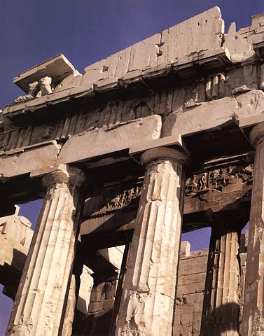
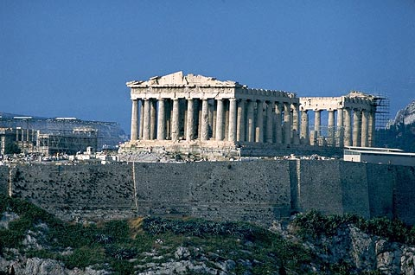
Parthenon (447-432 B.C.)
View from the Southwest
Parthenon, West façade

Slide 3
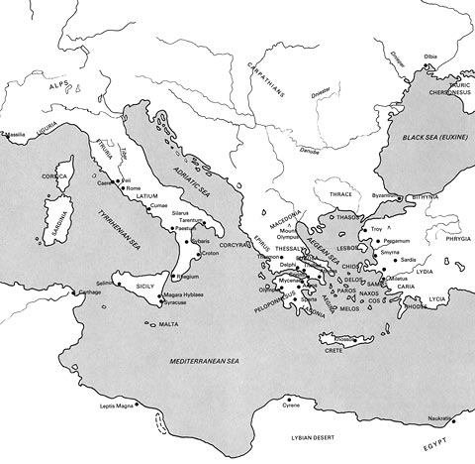
Map of the Greek
and Roman world

Slide 4
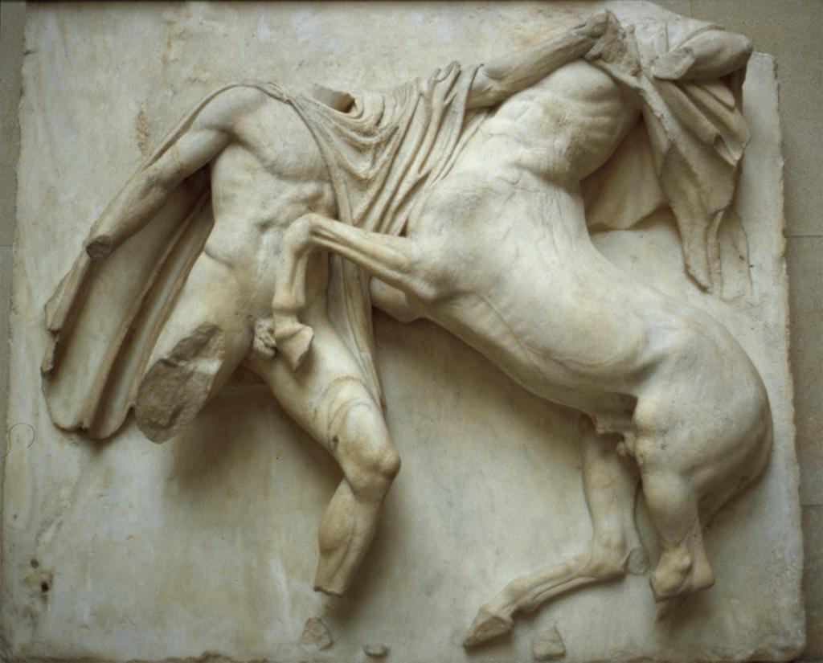
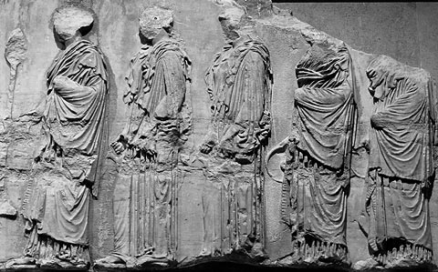
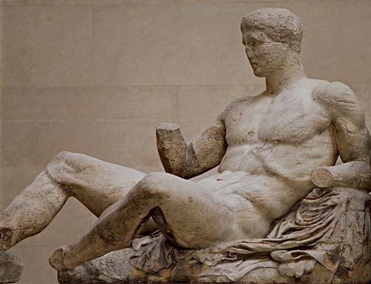
Parthenon sculptures
metope
(high-relief)
fragment from the Ionic frieze
(low-relief)
figure from the pediment
(free-standing sculpture)

Slide 5
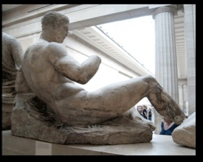
Reclining male figure (perhaps Dionysos or Herakles)
originally located on the East pediment of the Parthenon

Slide 6
Parthenon sculptures
metope
(high-relief)
fragment from the Ionic frieze
(low-relief)
figure from the pediment
(free-standing sculpture)

Slide 7
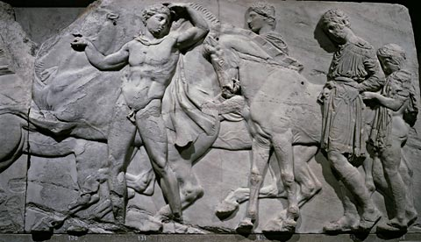
Pediment figure: Dionysos or Herakles
Ionic frieze: Unmounted horsemen

Slide 8
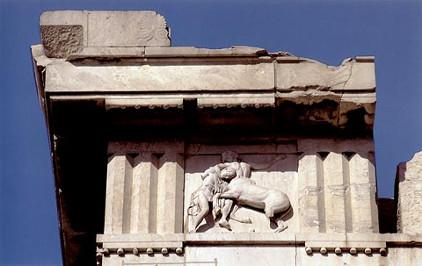
Parthenon, Metope in situ

Slide 9
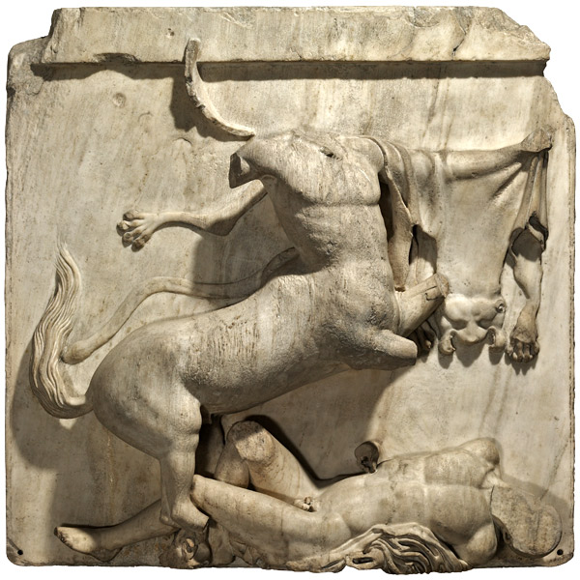
Metope number 28: Centaur rearing triumphantly over a fallen Lapith

Slide 10
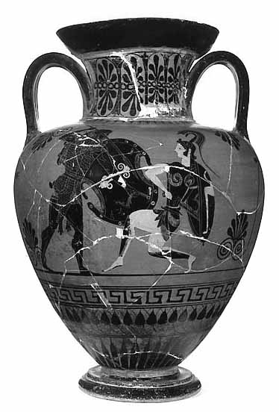
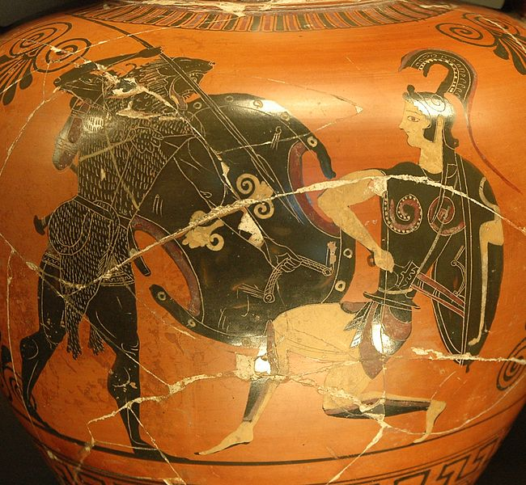
Herakles and the Amazons
Amphora, c. 530-530 B.C.

Slide 11
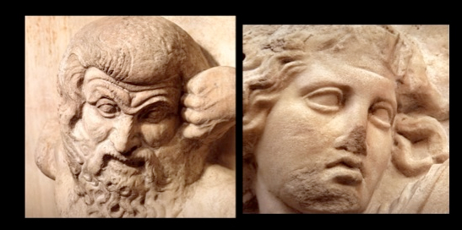
Detail of a metope: Face of a Centaur
Detail of a metope: Face of a Lapith

Slide 12
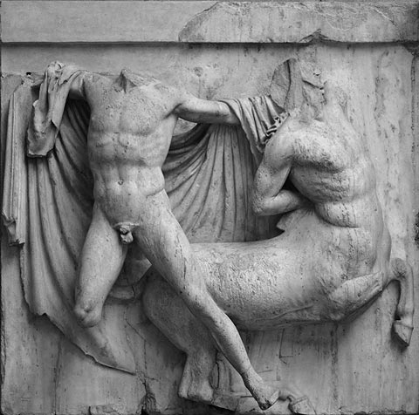
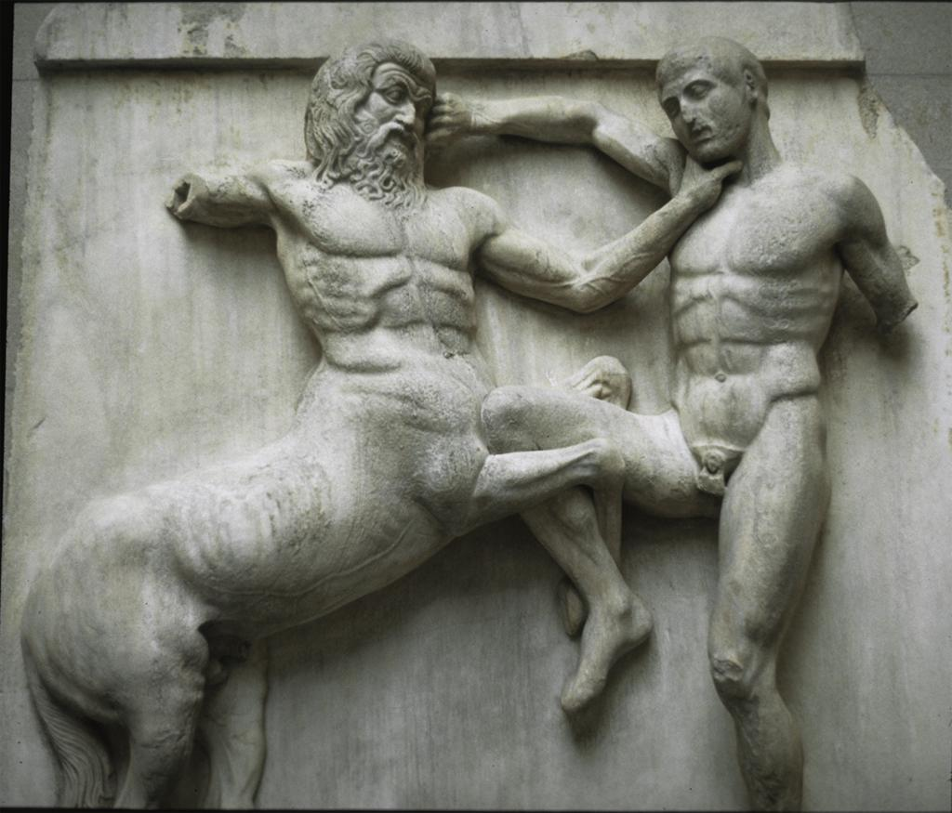
Metopes
Number 31
Number 27

Slide 13
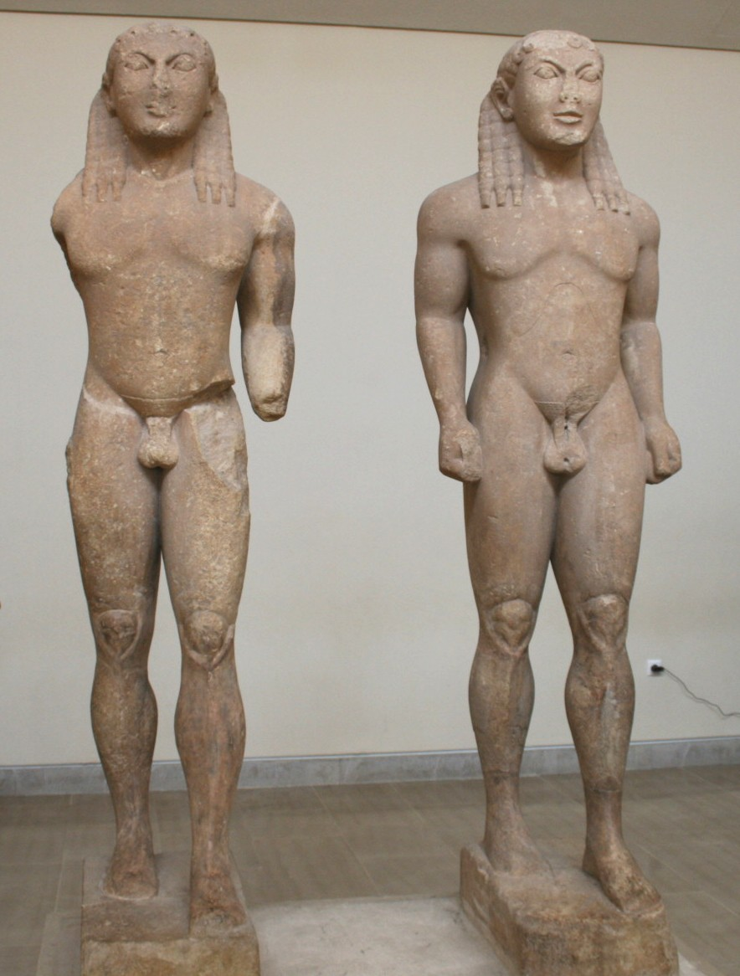
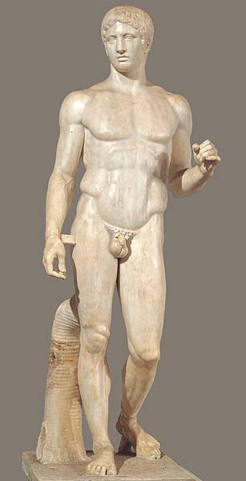
Twins of Argos
c. 580 B.C.
Roman copy of Polycleitos’ Doryphoros
Original c. 440 B.C.

Slide 14
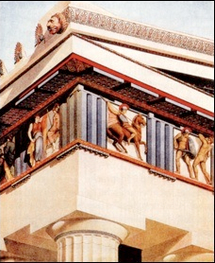
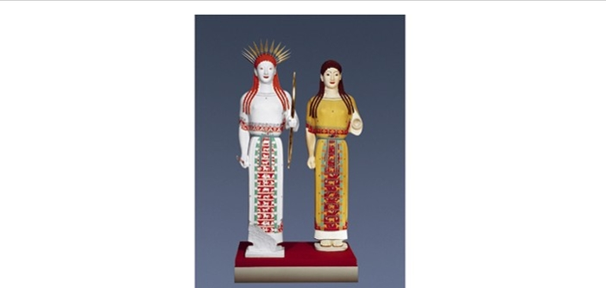
Polychromy in Greek sculpture
Examples of colored reconstructions
Parthenon metope
“Peplos” Kore
Originals:
c. 530 B.C.

Slide 15
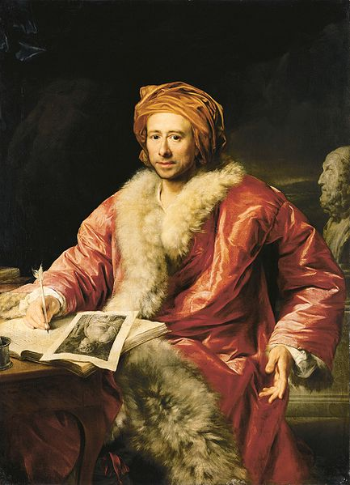
“a noble simplicity and calm grandeur”
Anton von Maron
Portrait of Johann Joachim Winckelmann, 1768
Roman copy of
Polycleitos’ Doryphoros

Slide 16
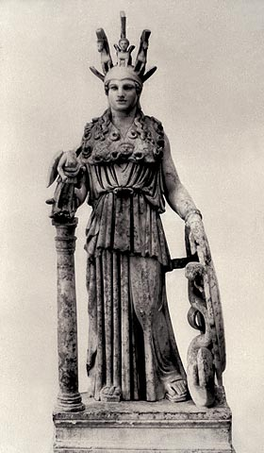
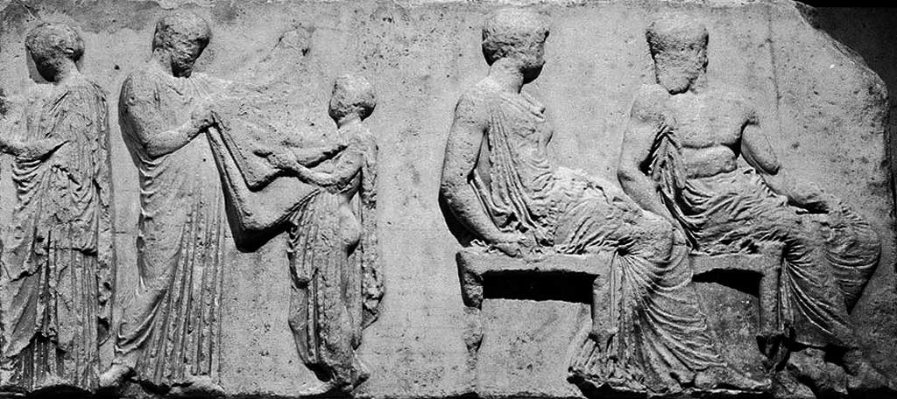
Ionic frieze: the Panathenaic Procession
Ritual act with the robe (peplos) of Athena; seated god and goddess identified as Athena and Hephaistos
Phidias, Athena Parthenos
Roman copy

Slide 17
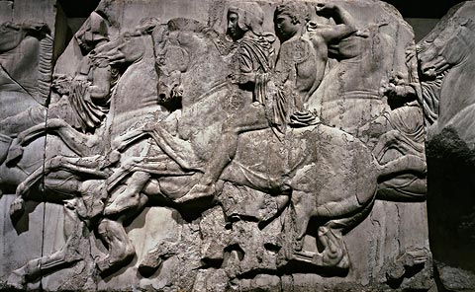
Horesmen

Slide 18
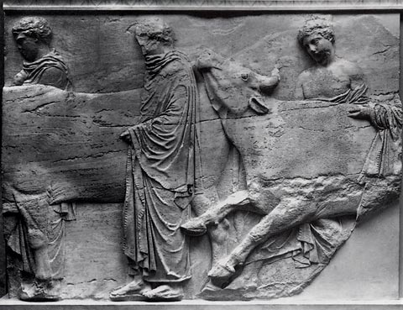
Youths leading cattle

